Slide 1
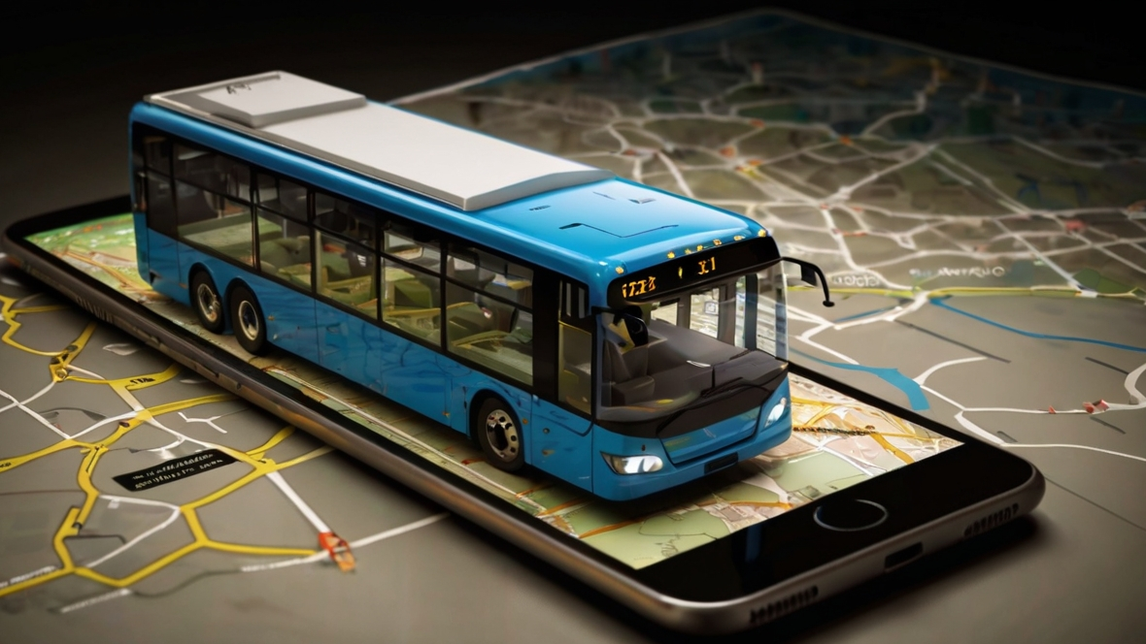

e-Conductor
Group 09
(Next Level of Sri Lankan Public Transport)
Department of Computer Engineering
Faculty of Engineering
University of Peradeniya
Sri Lanka

Slide 2
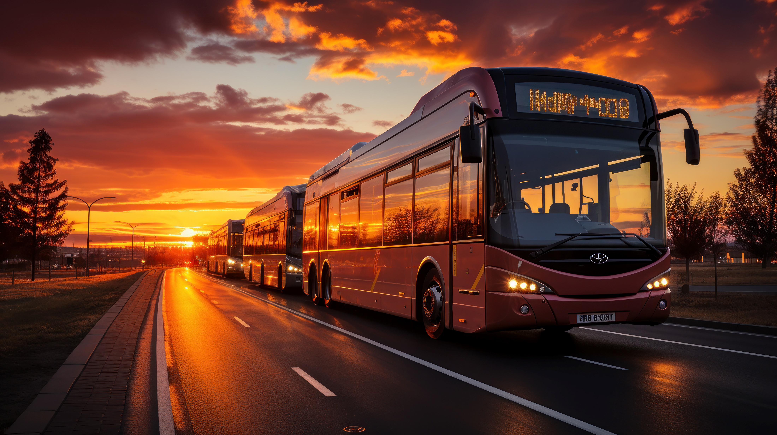
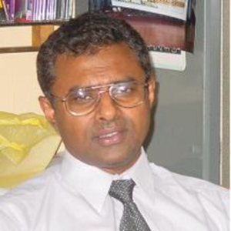
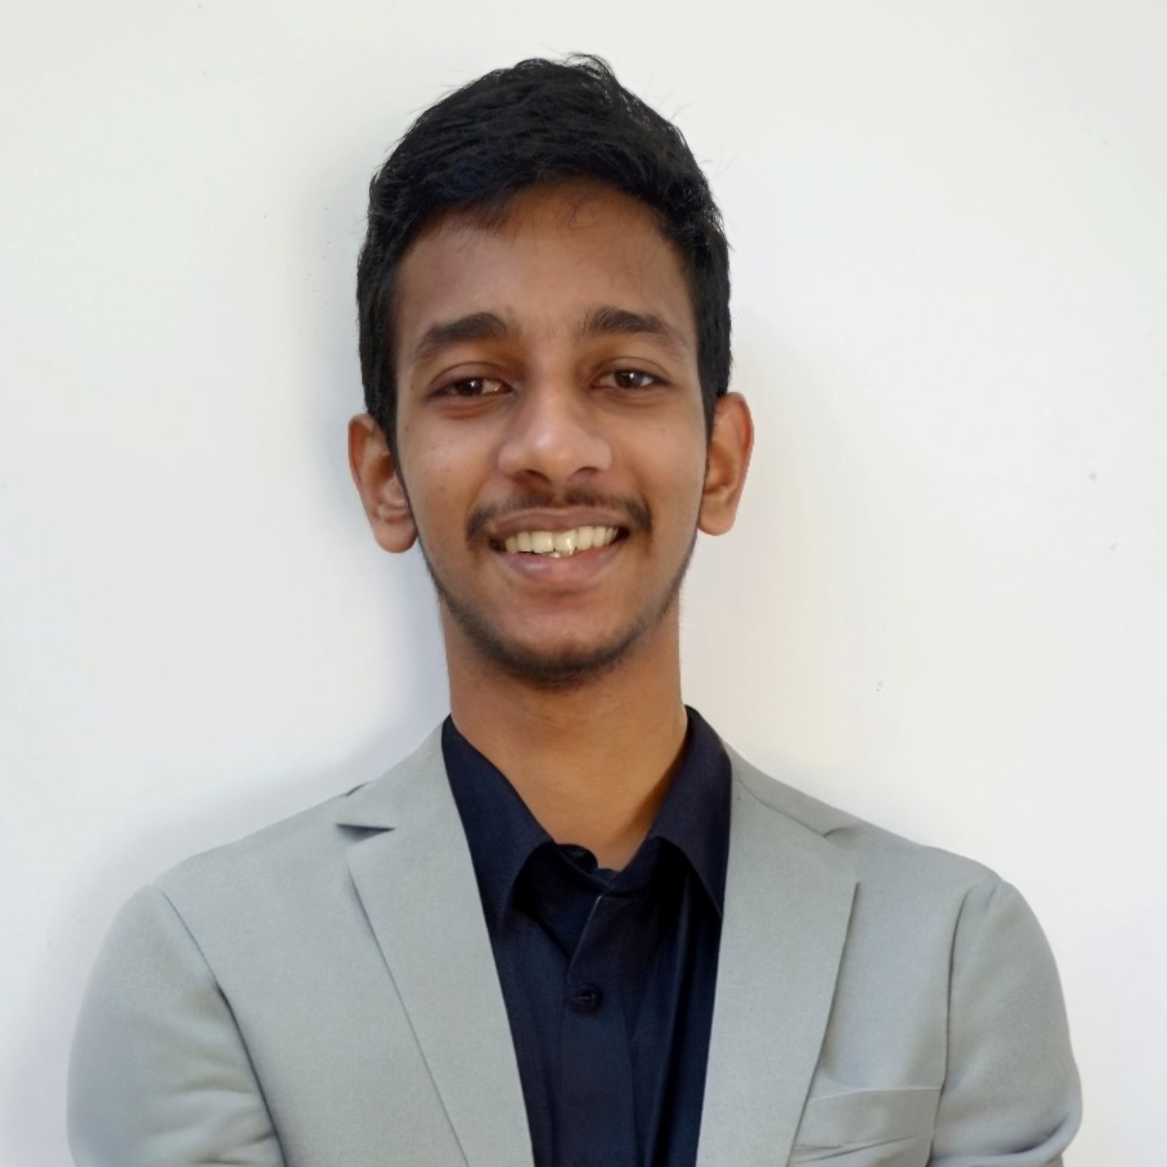


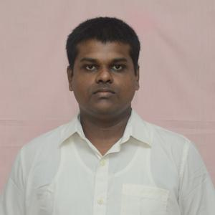
OUR TEAM
SUPERVISOR
Prof. Manjula Sandirigama
E/20/032
Bandara A.M.N.C.
E/20/035
Bandara K.C.H.N.A.W.M.R.C.J.N.
E/20/133 Haththella H.A.D.T.N.
E/20/157
Janakantha S.M.B.G.

Slide 3
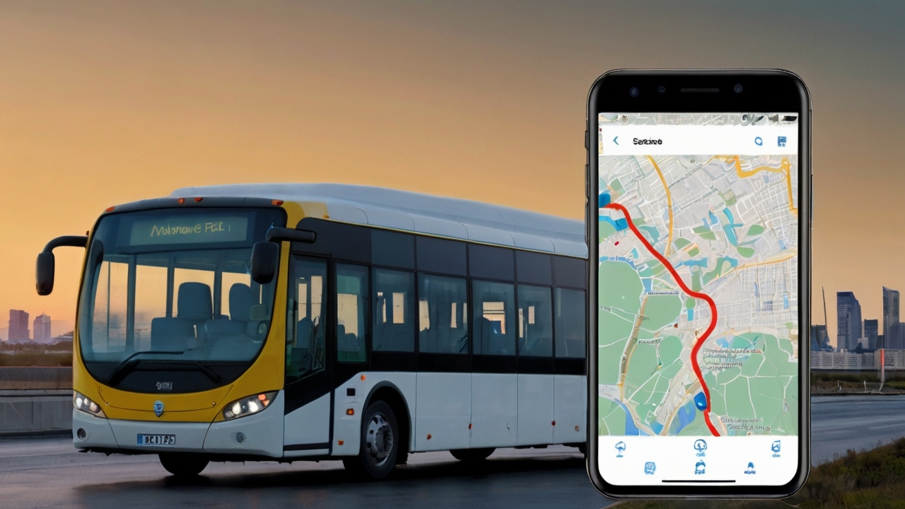
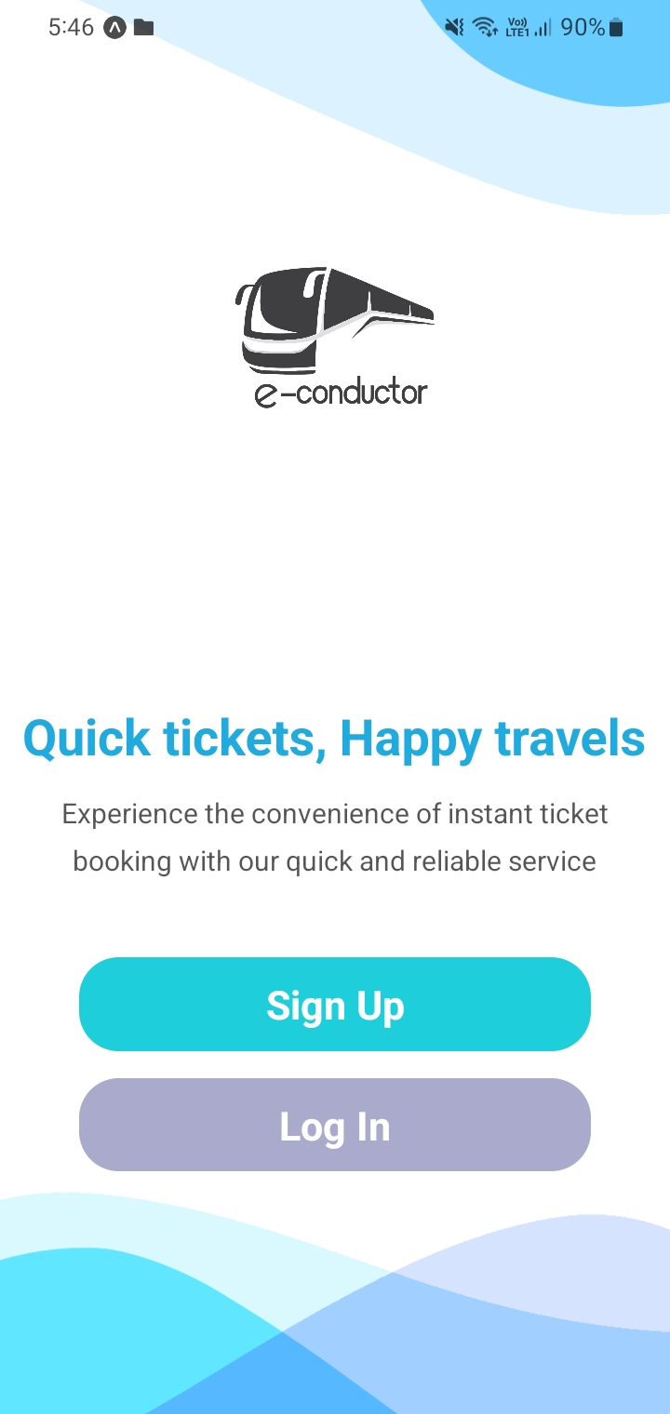





INTRODUCTION
Provide a convenient online platform
Streamline booking process, enhance user experience.
Search routes, select seats, live location tracking
Convenience, ease of use compared to traditional methods.
Improving accessibility to bus travel

Slide 4
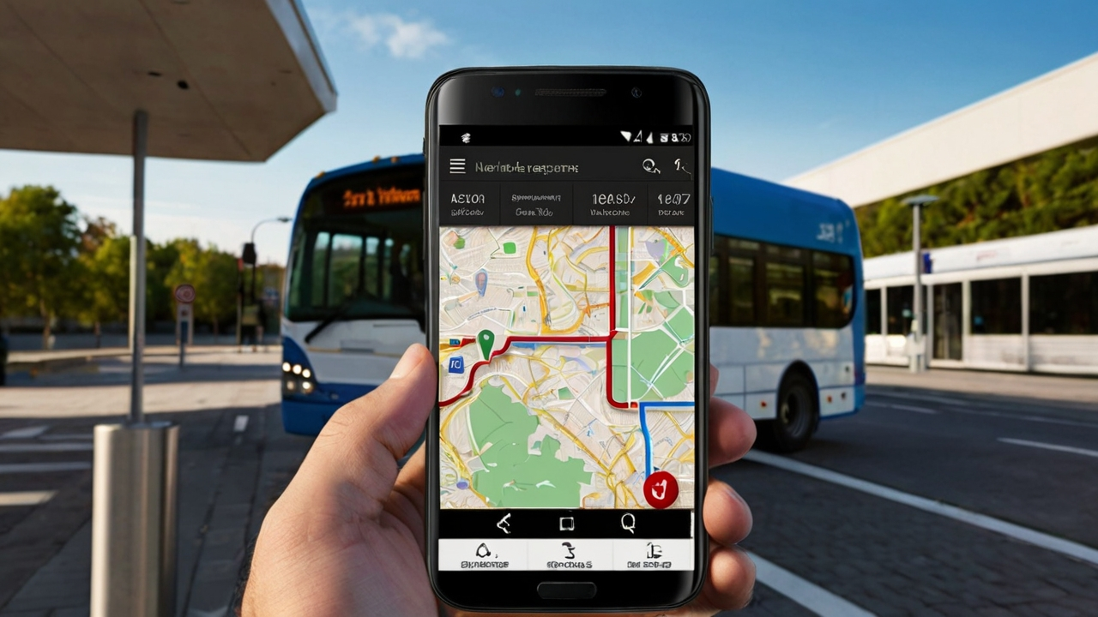



REQUIREMENTS OVERVIEW

Slide 5
FUNCTIONAL
User Registration
User Login
Authentication
Route Searching
Seat Selection
Booking
Confirmation
Cancellation
Payment
Rating

Slide 6
NON FUNCTIONAL
Performance Metrics
Security Measures
Scalability
Usability

Slide 7
CONSTRAINTS & ASSUMPTIONS
CONSTRAINTS
Budget Constraints
Device Capabilities
Regulatory Compliance
Technology Stack
ASSUMPTIONS
Active User Limit
Maximum Credits
User Information
(NIC, NTC Reg. No)

Slide 8
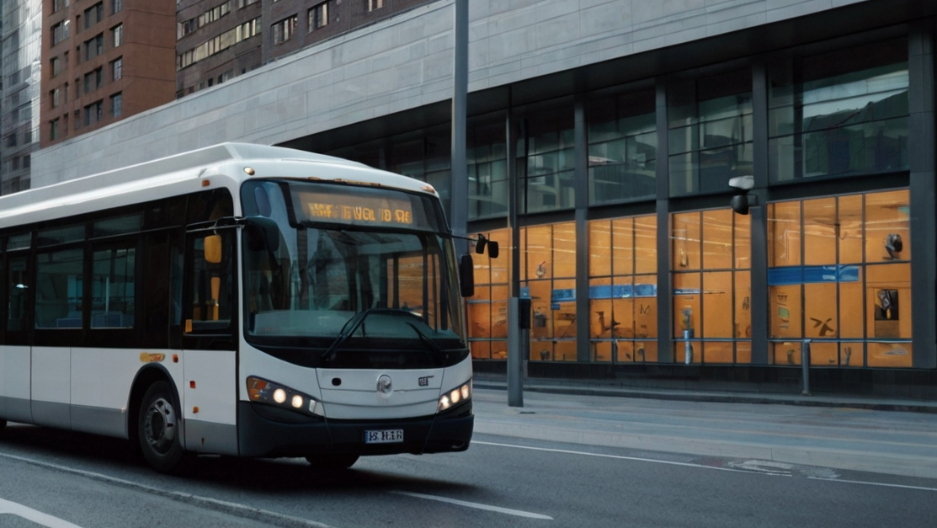












SYSTEM ARCHITECTURE

Slide 9
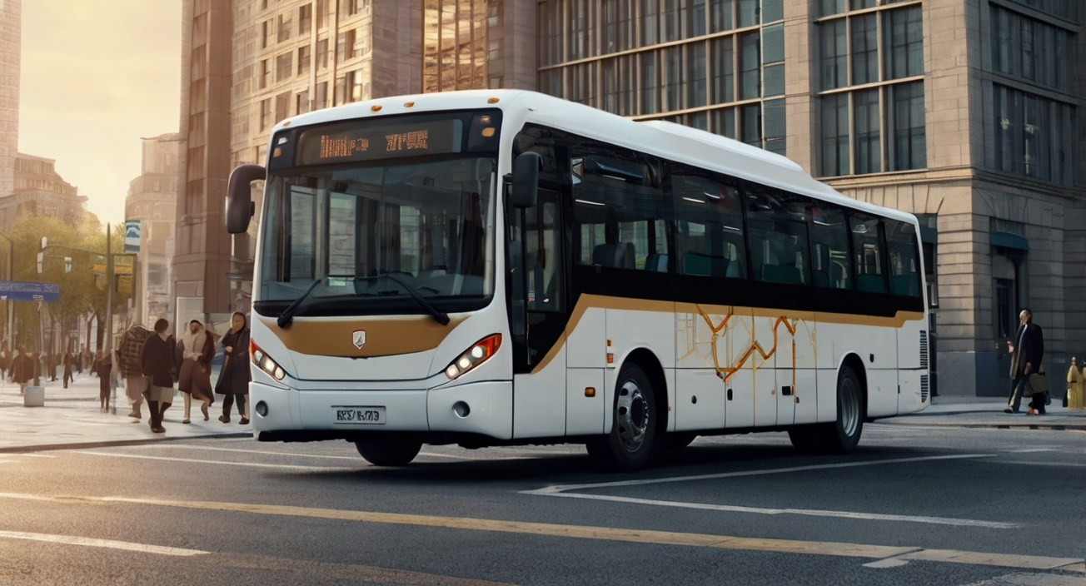
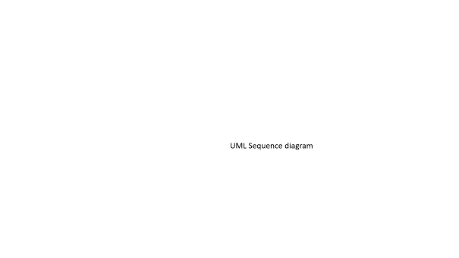
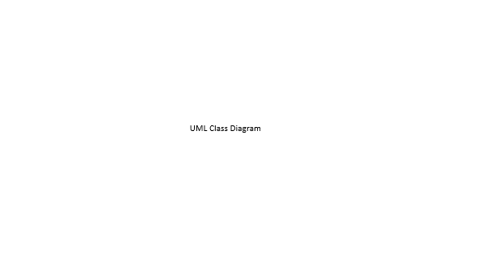
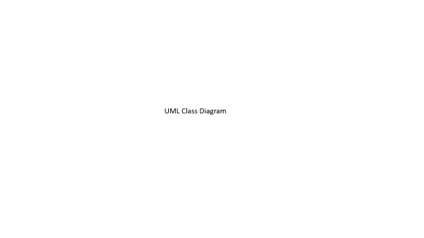
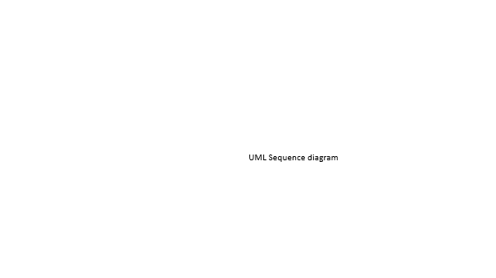
DETAILED DESIGN
UML Class Diagram
UML Sequence Diagram

Slide 10
UML Class Diagram

Slide 11
UML Sequence diagram

Slide 12
UML Sequence diagram2

Slide 13
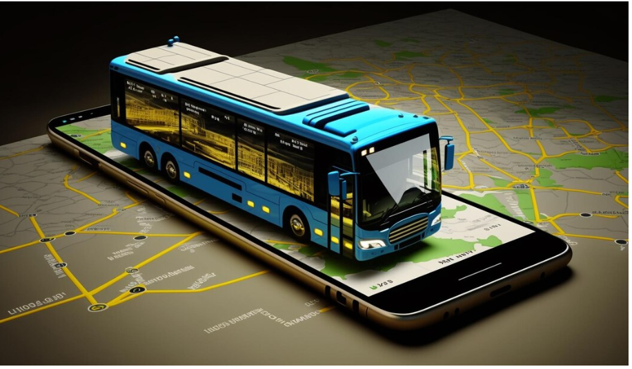
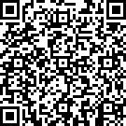








DATA MODEL

Slide 14
Page 1

Slide 15
Page 2

Slide 16
Page 3

Slide 17
Page 4

Slide 18
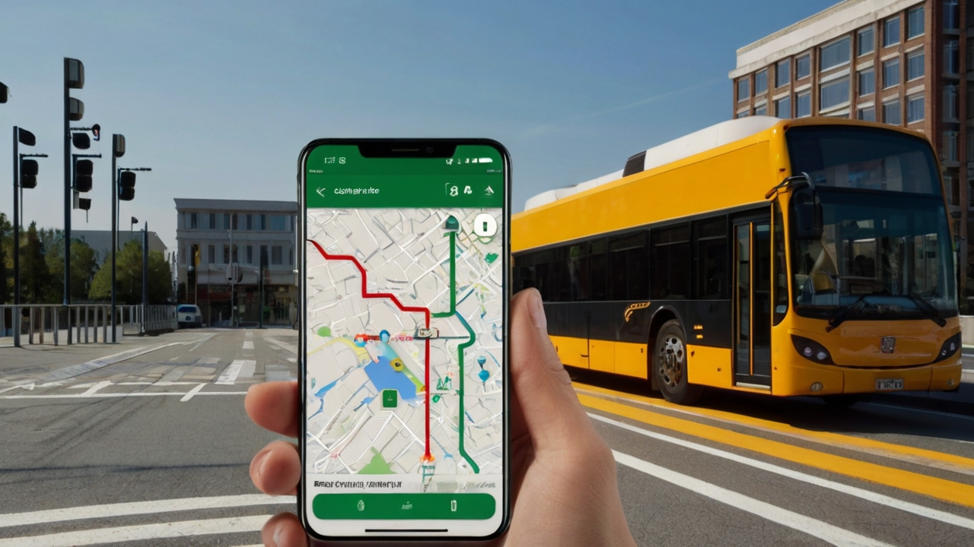



HIGHLIGHTS
Developer Tools
Hosting
Location Tracking System
Real-time Seat Availability Updates
Secure Payment Processing

Slide 19
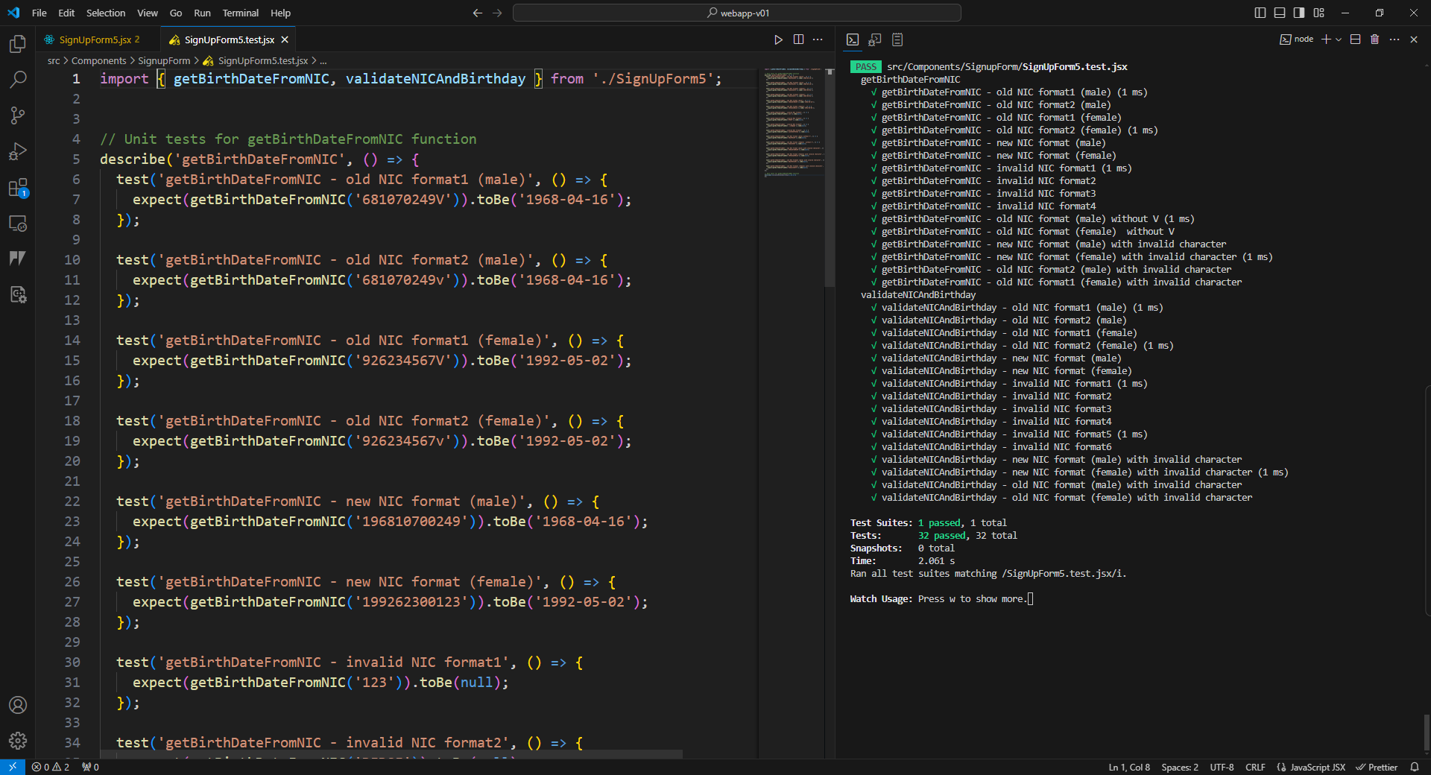



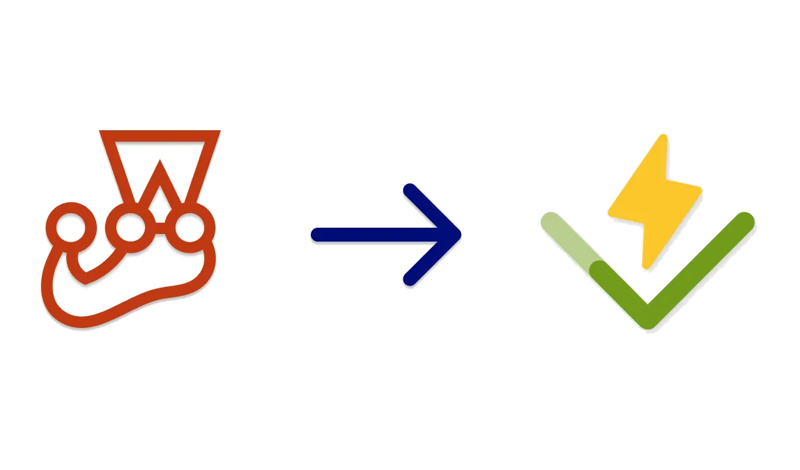
TESTING

Slide 20
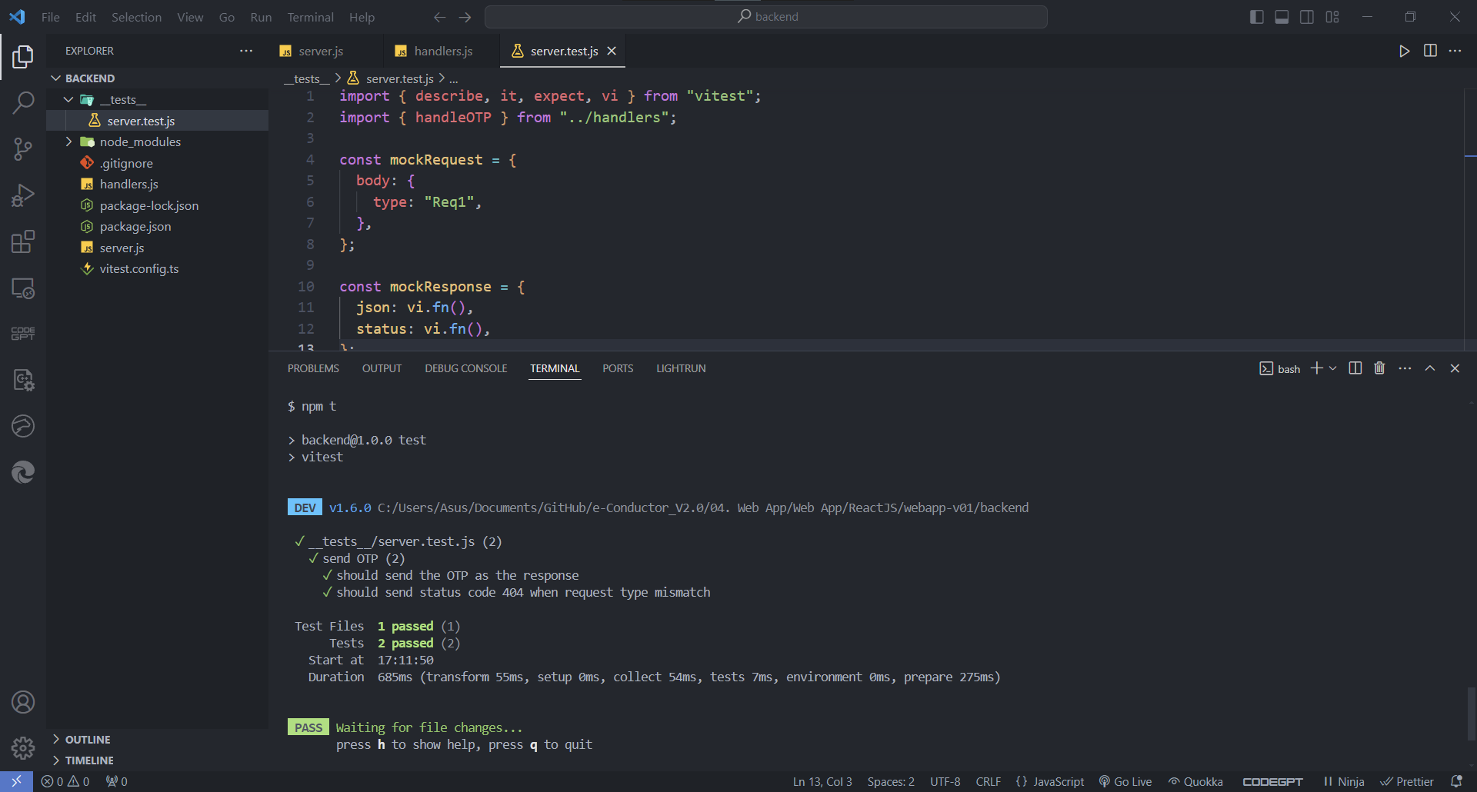
TESTING

Slide 21
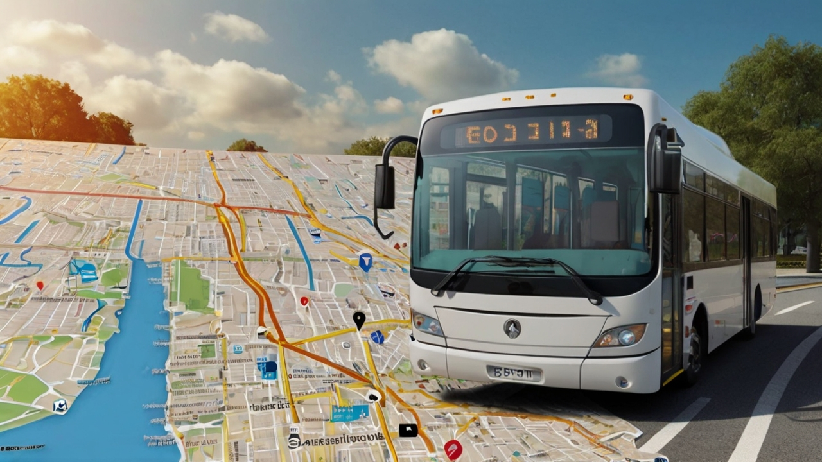
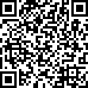


DEMONSTRATION
OVERALL PROGRESS
OTP: abc123
Web
App
Mobile App
Database
Backend

Slide 22
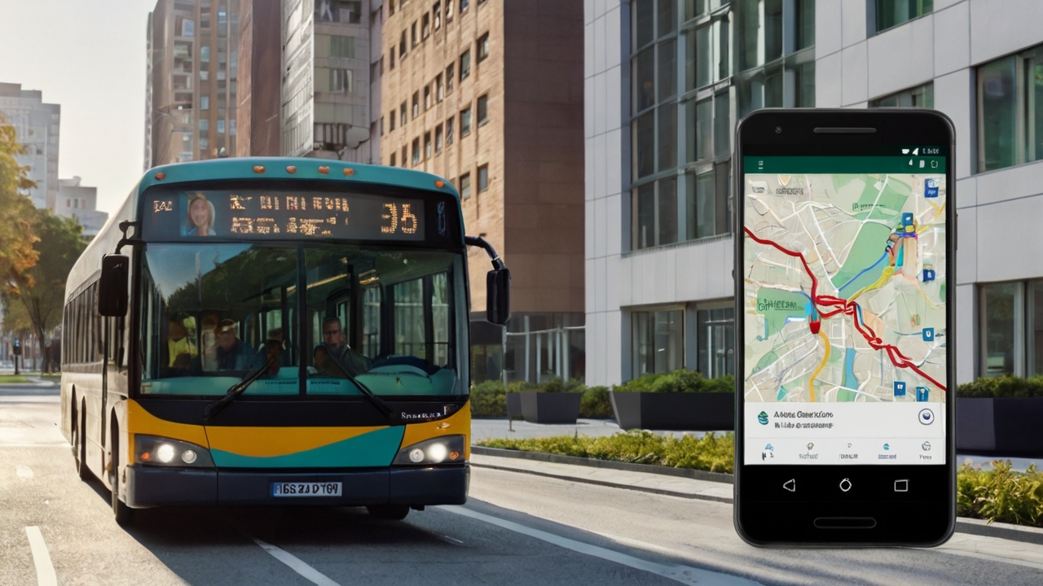





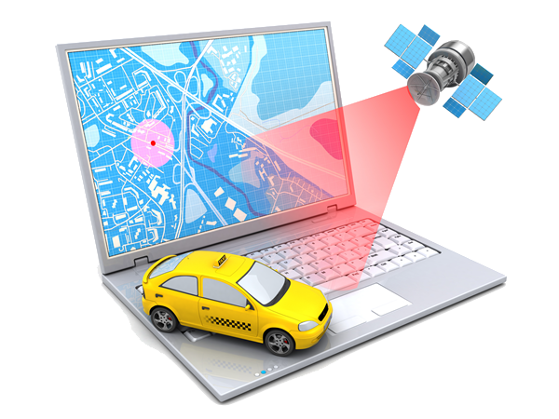
FUTURE WORK
THANK YOU
Web App
Mobile App
Database
Testing & Debugging
Payment Gateway
App Launching
Backend
Live Location Tracking

Slide 23
THANK YOU
Web App
Mobile App
Database
Testing & Debugging
Payment Gateway
App Launching
Backend
Live Location Tracking

